Slide 1
ASP.NET Core and Docker in Azure
Bill Pratt
Lead Software Engineer at Vistaprint

Slide 2
Bill Pratt
Twitter: @dev_enginerd
Blog: wmpratt.com
Github: https://github.com/billpratt
Talk slides and demos: https://github.com/billpratt/DotNetDockerExamples

Slide 3

.NET Cross Platform History
Cross platform since 2001
Open Source
Sponsored by Microsoft and Xamarin
Linux | Mac (OS X, iOS, tvOS, watchOS)
Sun Solaris | BSD (OpenBSD, FreeBSD, NetBSD)
Windows | Wii
PlayStation 3 & 4 | Embedded

Slide 4
.NET Core
New .NET stack – CLR + BCL
Initially forked from .NET Framework
Cross Platform
Open Source on GitHub
https://github.com/dotnet/core
Refactored BCL
Current Versions: 1.0 LTS, 1.1
Next version: 2.0 (Q3 2017)
Windows (incl. Nano Server) | OS X
Debian | Ubuntu
Red Hat | Centos
openSUSE | Fedora

Slide 5
ASP.NET Core
“New open-source and cross-platform framework for building modern cloud based internet connected applications, such as web apps, IoT apps and mobile backends”
Runs on .NET Core or full .NET Framework
A unified story for building web UI and web APIs
New light-weight and modular HTTP request pipeline
host on IIS or self-host in your own process
Ships entirely as NuGet packages
Reference packages, not assemblies
Build and run cross-platform on Windows, Mac and Linux
Open source and community focused

Slide 6
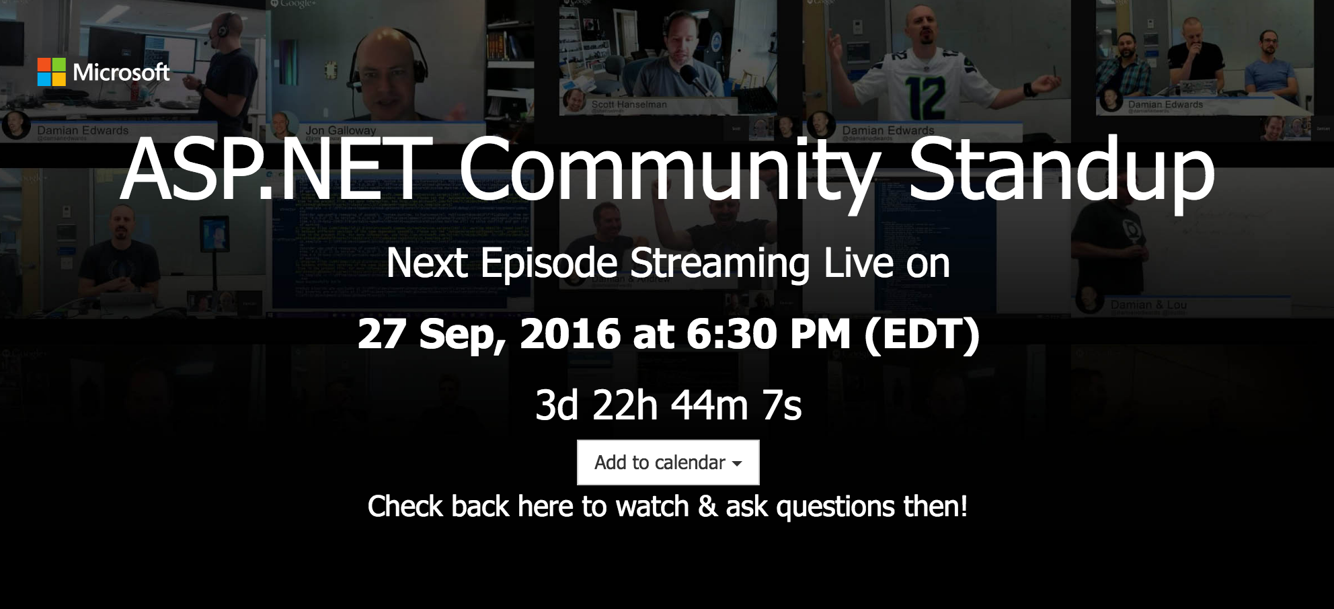
Ongoing live weekly standup with Scott Hanselman, Damian Edwards and other Microsoft devs
First episode aired Nov. 4 2014
Keeps community engaged with progress
https://live.asp.net

Slide 7
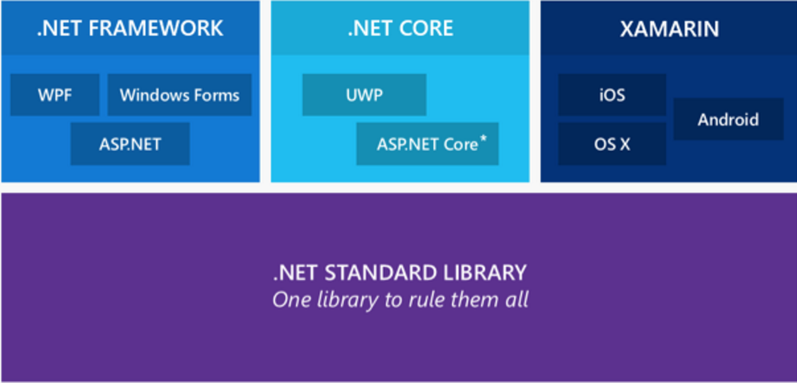
.NET Standard
Details: http://bit.ly/2b1JoHJ
Replaces PCL
Enables developers to produce portable libraries that are usable across .NET runtimes

Slide 8
How do I get started?
Install .NET Core from http://dot.net/
Windows: https://www.microsoft.com/net/core#windowsvs2017
macOS: https://www.microsoft.com/net/core#macos
Linux: https://www.microsoft.com/net/core#linuxubuntu
Docker: https://www.microsoft.com/net/core#dockercmd

Slide 9
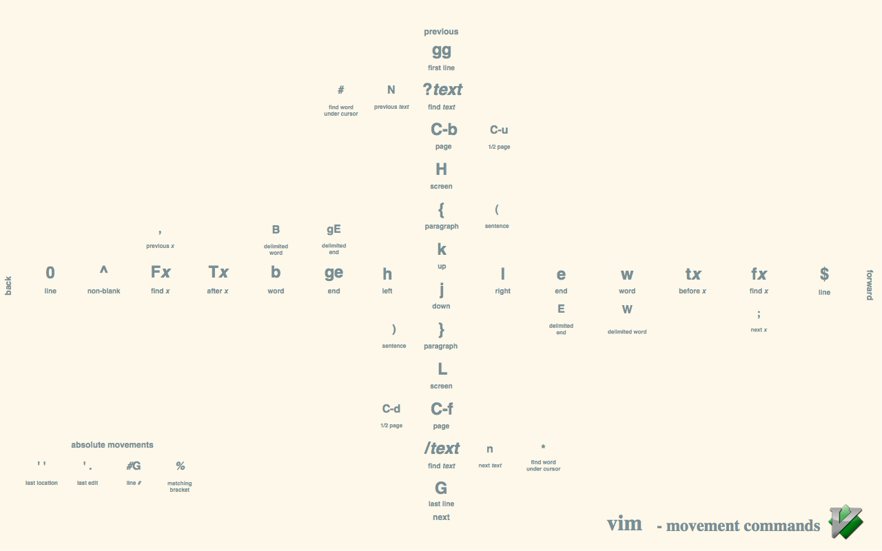
Editors? Just use VIM!

Slide 10


Slide 11
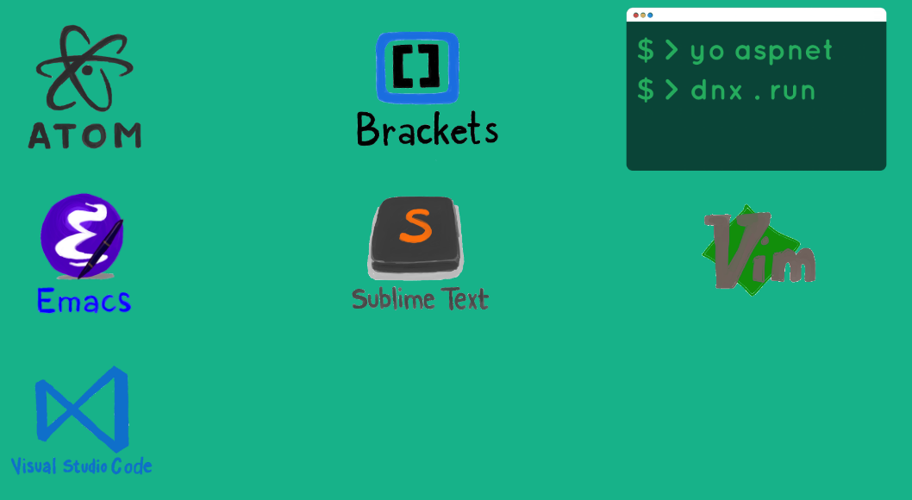
Editors
Visual Studio 2017
Visual Studio for Mac
Visual Studio Code
Rider - Jetbrains
Other supported OmniSharp editors: http://www.omnisharp.net/

Slide 12


Slide 13
ASP.NET Core Demo

Slide 14
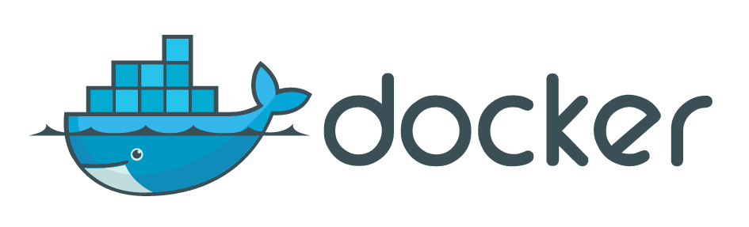

Slide 15
What’s a container?
Virtual Machine = “Virtual Hardware w/ OS”
Container = “Virtual Operating System”
Unlike VMs, containers do not bundle a full operating system - only libraries and settings required to make the software work are needed
Makes for efficient, lightweight, self-contained systems and guarantees that software will always run the same, regardless of where it’s deployed

Slide 16
What’s a Container?
www.docker.com/what-container

Slide 17
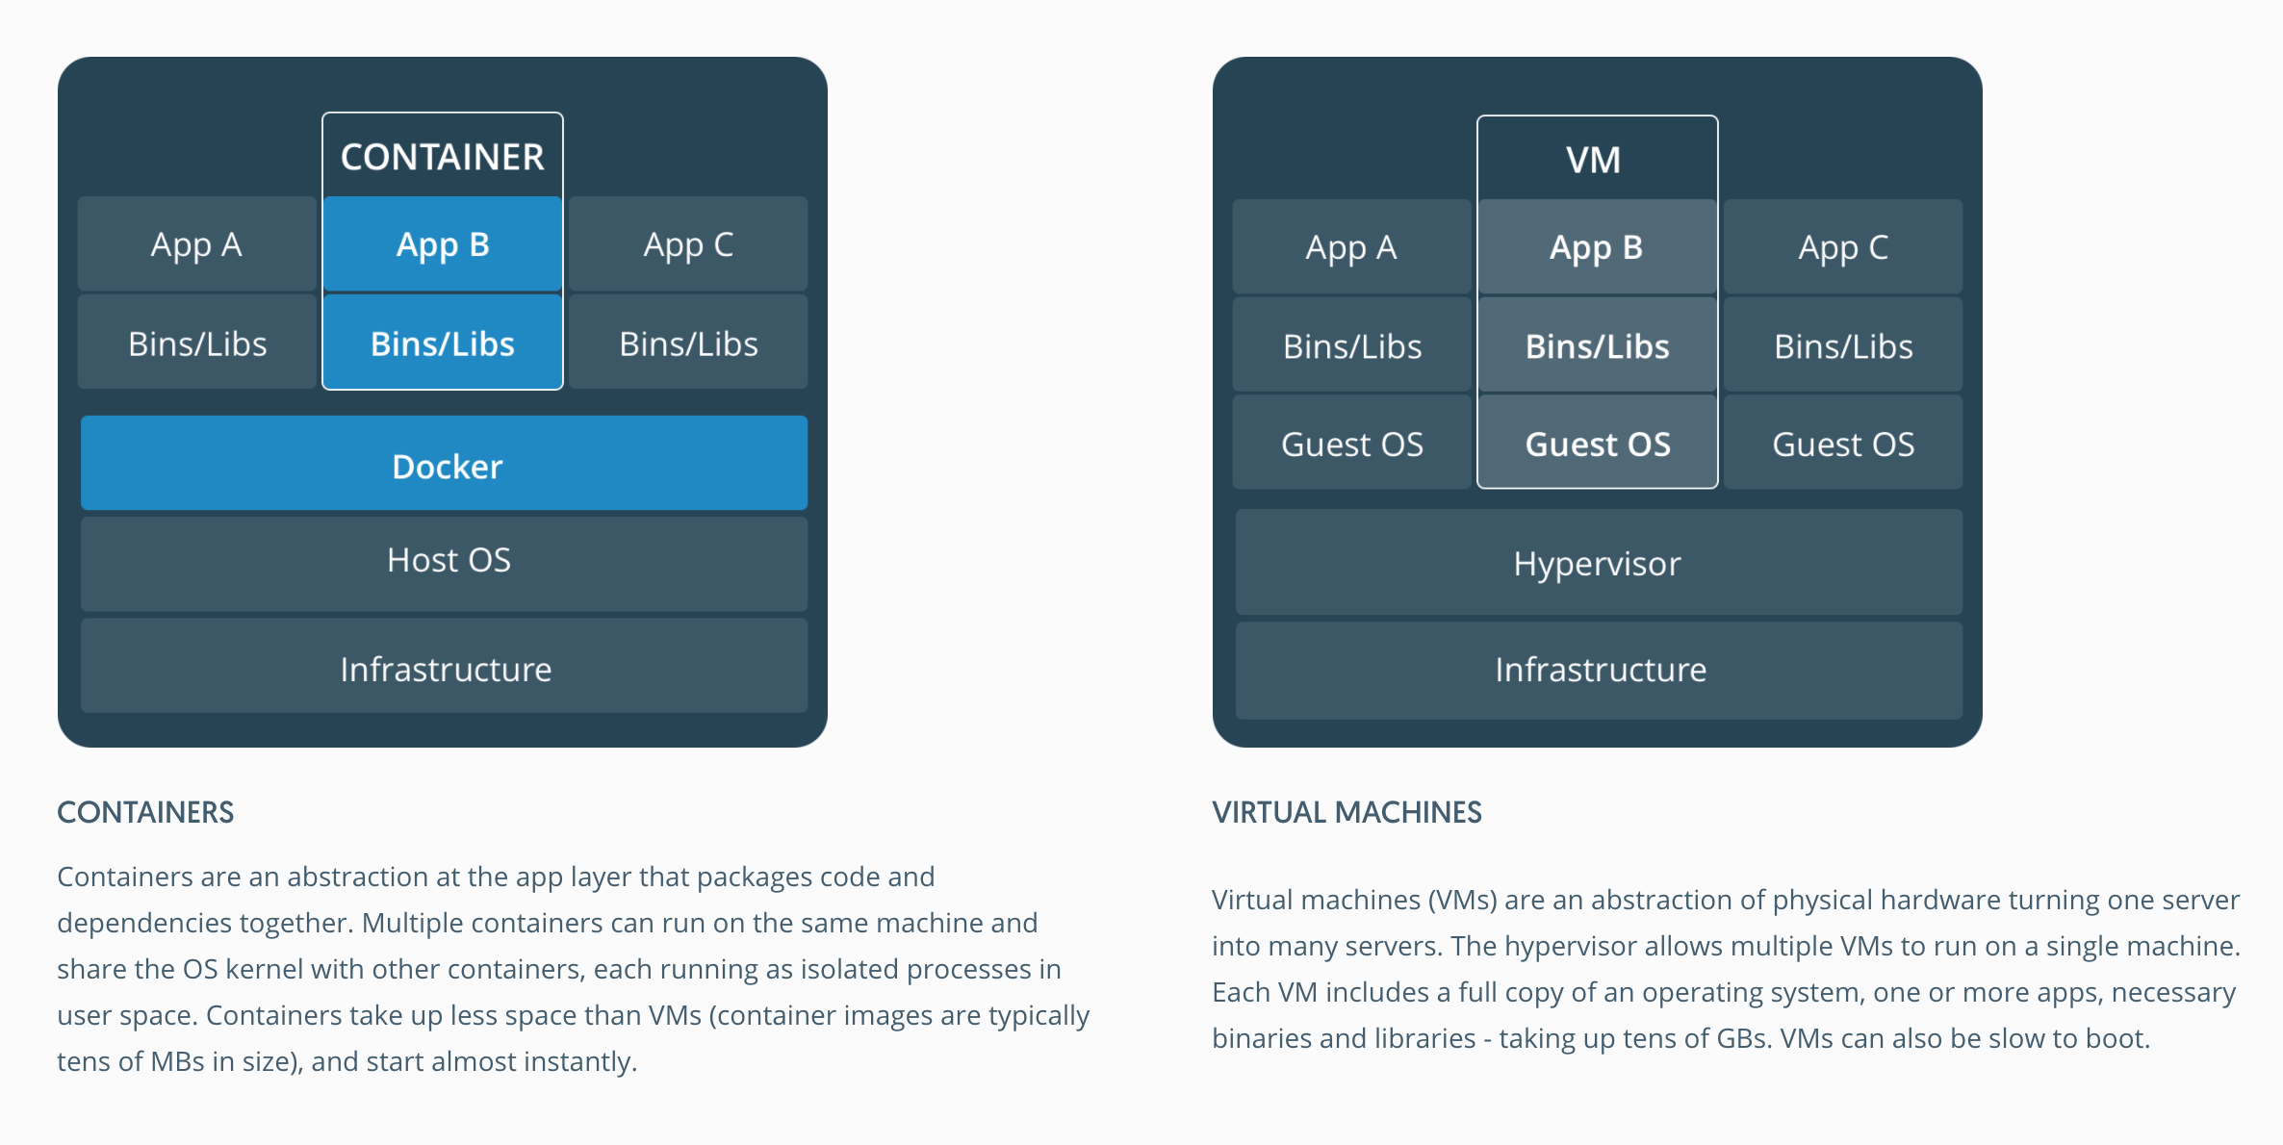
www.docker.com/what-container

Slide 18
Get started with Docker
Docker for Mac: https://www.docker.com/docker-mac
Docker for Windows: https://www.docker.com/docker-windows
Useful Resources:
Swarm Lab: https://github.com/billpratt/docker-azure-workshop
http://training.play-with-docker.com/
https://www.katacoda.com/courses/docker
https://github.com/docker/labs
https://docs.docker.com/

Slide 19
ASP.NET Core w/ Docker Demo

Slide 20
Container Orchestrators
www.kubernetes.io
docs.docker.com/engine/swarm
www.dcos.io

Slide 21
Azure Container Service
https://azure.microsoft.com/en-us/services/container-service

